Slide 1
Programming Fundamentals
Lecture 17
Ms. Farah Younas

Slide 2
Agenda of Lecture
Passing arguments
Returning value to calling function
Pass by value
Pass by reference
Overloaded function

Slide 3
The Function Declaration
As you can’t use a variable without first telling the compiler what it is, you also can’t use a function without telling the compiler about it.
There are two ways to do this:
To declare the function before it is called.
To define it before it’s called.

Slide 4
The Function Declaration
the function starline() is declared in the line
void starline();
The declaration tells the compiler that at some later point we plan to present a function called starline.
The keyword void specifies that the function has no return value
The empty parentheses indicate that it takes no arguments.

Slide 5
The Function Declaration
Prototypes
Function declarations are also called prototypes.
since they provide a model or blueprint for the function.
they tell the compiler, “a function that looks like this is coming up later in the program.

Slide 6
The Function Declaration
Function Signature
The information in the declaration (the return type and the number and types of any arguments) is also sometimes referred to as the function signature.

Slide 7
Calling the Function
The function is called (or invoked, or executed) three times from main().
Each of the three calls looks like this:
starline();

Slide 8
Calling the Function
What we need to call a function:
The function name, followed by parentheses e.g
starline();
The syntax of the call is very similar to that of the declaration, except that the return type is not used.
The call is terminated by a semicolon.

Slide 9
Calling the Function
Executing the call statement causes the function to execute;
that is, control is transferred to the function,
the statements in the function definition are executed,
and then control returns to the statement following the function call.

Slide 10
The Function Definition
The definition contains the actual code for the function.
the definition for starline():
void starline() //declarator
{
for(int j=0; j<45; j++) //function body
cout << ‘*’;
}

Slide 11
The Function Definition
The definition consists of a line called the declarator, followed by the function body.
The function body is composed of the statements that make up the function, delimited by braces.

Slide 12
The Function Definition
The declarator must agree with the declaration:
It must use the same function name.
Have the same argument types in the same order (if there are arguments).
And have the same return type.
The declarator is not terminated by a semicolon

Slide 13
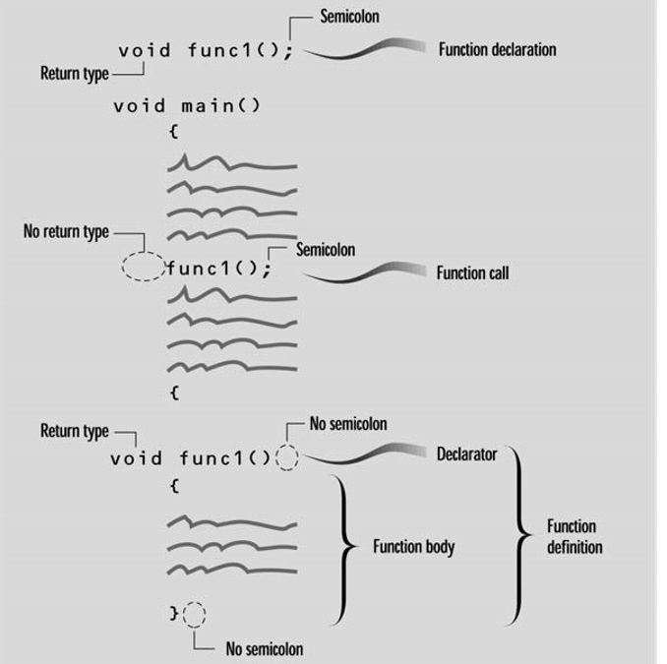
Syntax of Function Definition

Slide 14
The Function Definition
When the function is called, control is transferred to the first statement in the function body.
The other statements in the function body are then executed, and when the closing brace is encountered, control returns to the calling program.

Slide 15
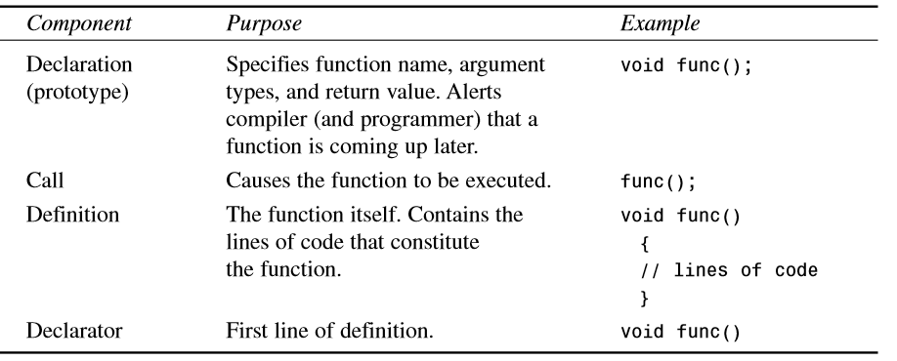
The Function Components

Slide 16
Comparison with Library Functions
ch = getche();
declaration is in the header file specified at the beginning of the program (CONIO.H, for getche()).
The definition (compiled into executable code) is in a library file that’s linked automatically to your program when you build it.

Slide 17
Comparison with Library Functions
When we use a library function :
we don’t need to write the declaration or definition.
But when we write our own functions:
the declaration and definition are part of our source file.

Slide 18
Eliminating the Declaration
The second approach to inserting a function into a program is :
to eliminate the function declaration
and place the function definition (the function itself) in the listing before the first call to the function.
See starline example.

Slide 19
Eliminating the Declaration
This approach is simpler for short programs, in that it removes the declaration, but it is less flexible.
To use this technique when there are more than a few functions, the programmer must give considerable thought to arranging the functions so that each one appears before it is called by any other.

Slide 20
Passing the Arguments in Functions
An argument is a piece of data (an int value, for example) passed from a program to the function.
Arguments allow a function to operate with different values, or even to do different things, depending on the requirements of the program calling it.

Slide 21
Passing the Arguments in Functions
int main ()
{
int z;
addition (5,3);
return 0;
}
int addition (int a, int b)
{
int r;
r=a+b;
cout << "The result is " << z;
}

Slide 22
Passing the Arguments in Functions
Passing Constants
Let’s suppose we decide that the starline() function in the last example is too rigid. Instead of a function that always prints 45 asterisks, we want a function that will print any character any number of times.
See example starline with arguments

Slide 23
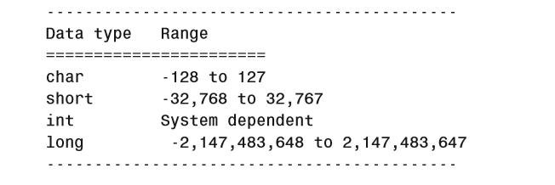
Passing the Arguments in Functions

Slide 24
Passing the Arguments in Functions
The new function is called repchar(). Its declaration looks like this:
void repchar(char, int); // declaration specifies data types
The items in the parentheses are the data types of the arguments that will be sent to repchar():
char and int.

Slide 25
Passing the Arguments in Functions
In a function call, specific values—constants in this case—are inserted in the appropriate place in the parentheses:
repchar(‘-’, 43); // function call specifies actual values
This statement instructs repchar() to print a line of 43 dashes

Slide 26
Passing the Arguments in Functions
The values supplied in the call must be of the types specified in the declaration:
the first argument, the - character, must be of type char;
and the second argument, the number 43, must be of type int.
The types in the declaration and the definition must also agree.

Slide 27
Passing the Arguments in Functions
The next call to repchar()
repchar(‘=’, 23);
tells it to print a line of 23 equal signs.
The third call again prints 43 dashes

Slide 28
Passing the Arguments in Functions
The calling program supplies arguments,such as ‘–’ and 43,to the function.
The variables used within the function to hold the argument values are called parameters. in repchar() they are ch and n.

Slide 29
Passing the Arguments in Functions
These parameter names, ch and n, are used in the function as if they were normal variables.
Placing them in the declarator is equivalent to defining them with statements like
char ch;
int n;
When the function is called, its parameters are automatically initialized to the values passed by the calling program

Slide 30
Questions??

